Slide 1

Department of ECE
ANALOG ELECTRONIC CIRCUIT DESIGN 22EC2104A
CO-2
Session-10 Common drain amplifier

Slide 2





AIM OF THE SESSION
To familiarize students with the operation of common drain amplifier
INSTRUCTIONAL OBJECTIVES
This Session is designed to:
Give introduction amplification in CD configuration
To analysis operation of CD amplifier
LEARNING OUTCOMES
At the end of this session, you should be able to:
1. Describe the working of CD amplifier circuits.
2. Demonstrate and analyze the operation and parameters of CD amplifier.

Slide 3
INTRODUCTION
The common drain amplifier, also known as the source follower configuration, is a widely used field-effect transistor (FET) amplifier in electronic circuits.
In this configuration, the input signal is applied to the gate terminal, and the output is taken from the source terminal, while the drain terminal is connected to a common reference point.
The common drain amplifier provides voltage buffering and offers a high input impedance, making it suitable for impedance matching between different stages of a circuit.
It has a voltage gain slightly less than unity but offers high current gain and low output impedance.
The common drain amplifier finds applications in audio preamplifiers, voltage followers, and impedance matching circuits.

Slide 4
Common drain amplifier
The following shows the source follower circuit in which drain terminal of the device is common. In this circuit the drain terminal is directly connected to V_{DD}.
In CS amplifier analysis we have seen that in order to achieve the high voltage gain the load impedance should be as high as possible.
Therefore for low impedance load the buffer must be placed after the amplifier to drive the load with negligible loss of the signal level.
The source follower thus worked as a buffer stage.
The source follower is also called as the common drain amplifier. In this circuit, the signal at the gate is sensed and drives the load at the source which allows the source potential to follow the gate voltage.
The small signal equivalent circuit of the source follower is shown in Figure below.

Slide 5
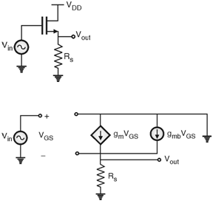
Analysis

Slide 6
Cont..
The values of:
  Input resistance (R_{in})
  Output resistance (R_{out})
  Voltage gain (A_{V})
Calculating these three will help us understand what we will get whenever we use this configuration in various circuits.
Finding the value of R_{in}, R_{out}, and A_{V} will show us how this amplifier interacts with the rest of the circuit.
First we will calculate the input resistance (R_{in}) by applying our test voltage source V_{test} to the gate and measure the test current (i_{test}) flowing out of it.

Slide 7


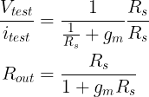
Output impedance Z_{O}
The input resistance is
voltage gain (AV)
output resistance Rout

Slide 8
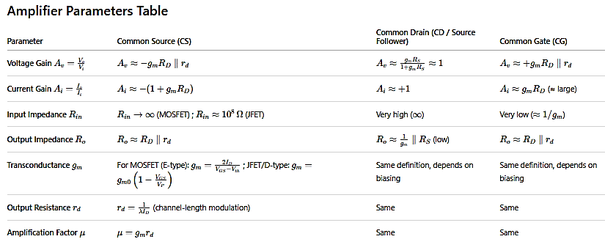
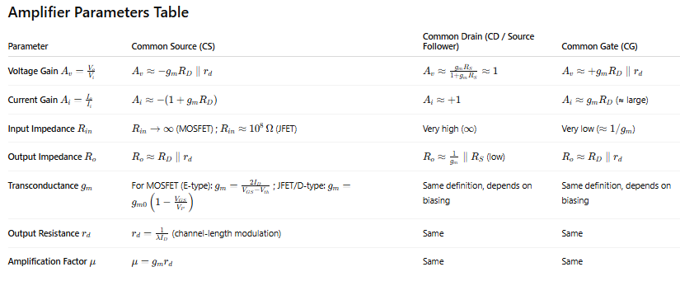

Slide 9
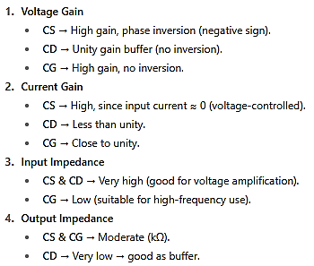
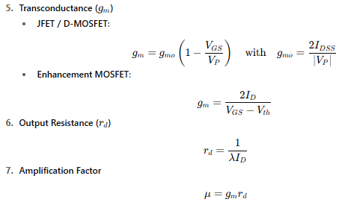

Slide 10
For CS: Provides high gain, 180° phase shift.
For CD: Provides voltage follower, unity gain, low output resistance, no phase shift.
For CG: Provides high voltage gain, no phase shift, but very low input resistance.
Applies to both JFET & MOSFET, with only difference in gm expression.

Slide 11

SUMMARY
The common drain amplifier, also known as the source follower, is a widely used configuration of a field-effect transistor (FET) amplifier.
It serves as a voltage buffer, providing high input impedance and low output impedance. In this setup, the input signal is applied to the gate terminal, and the output is taken from the source terminal, while the drain terminal is connected to a common reference point.
The common drain amplifier offers voltage gain slightly less than unity but provides high current gain and excellent signal isolation.
It is commonly utilized in applications such as audio preamplifiers, impedance matching circuits, and as a buffer between different stages of a circuit to prevent loading effects.

Slide 12
SELF-ASSESSMENT QUESTIONS
1. The common-drain amplifier provides a relatively:
a) Large output swing
b) Small output swing
c) Balanced output swing
d) No output swing
2. The common-drain amplifier can be used for:
a) Impedance matching
b) Frequency mixing
c) Voltage amplification
d) Power amplification

Slide 13
TERMINAL QUESTIONS
1. Draw the small signal model of common drain amplifier
2. Derive the expression for voltage gain of common drain amplifier

Slide 14
REFERENCES FOR FURTHER LEARNING OF THE SESSION
Reference Books:
1. Jacob Millman - “Electronic Devices and Circuits”, 4th Edition, McGraw Hill Education (2015)
2. D Roy Choudhury and Shail B. Jain – “Linear Integrated Circuits”, 4th Edition, New Age International Pvt.Ltd. (2017)
3. David A. Bell - “Electronic Devices and Circuits”, 5th Edition, Oxford University Press (2008)
Sites and Web links:
https://www.learnelectronicswithme.com/2020/07/what-is-jfet-construction-and-working.html
https://electronicspost.com/explain-the-construction-and-working-of-a-jfet-what-is-the-difference-between-a-jfet-and-a-bjt/
https://electronicsdesk.com/junction-field-effect-transistor.html

Slide 15
THANK YOU
Team – ANALOG ELECTRONIC DEVICES AND CIRCUITS

